Slide 1
Choosing a Social Network Tool: An Introduction for Non-specialists
December 5, 2013
Nathaniel Porter, Penn State University
Quantitative Social Science Initiative
ndp135@psu.edu

Slide 2
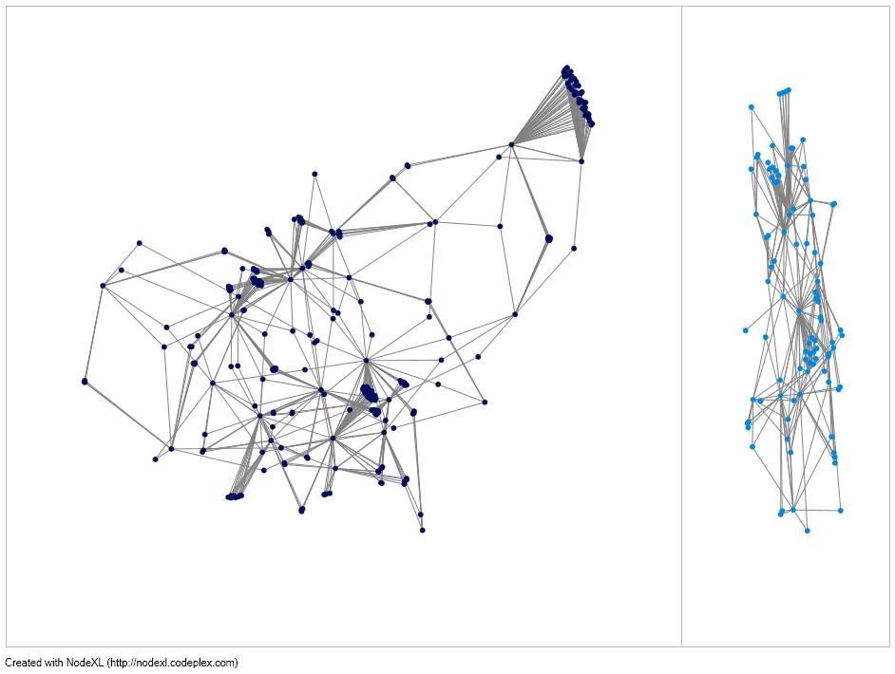
Standard Regression
Social Networks

Slide 3
Why integrate?
Data
Captures social concepts typically measured at individual level
Social Capital
Power
Homophily
Theory
Bridges from Micro to Macro
System ⬄ Individual cross-talk
Non-obvious and counterintuitive findings
Ex: Strength of Weak Ties (jobs through acquaintances, not closest friends)
Ex: MMA (pay tracks success against strong competitors more than entertainment value)
Social diffusion processes
Tools and Visual Presentation

Slide 4
Why not integrate?
No data!
Rare to see full network data on representative surveys
Ego network data (asking people about characteristics of their friends, even if the friends are not survey)
Popularity is increasing and certain measures can be calculated from ego networks
No theory
Limited body of canonical social network theory
Familiarity can be an issue- different way of thinking than traditional individual analysis
Integrating the two (regression and SNA) can be a challenge
No tools or knowledge
Depending on the question, data management and interpretation can be time consuming

Slide 5
What does integration look like?
Short answer:
Summarize network features for individuals and include in regression
Three longer answers:
Network position and role- popularity, prestige, group membership, bridges
Friend attributes- information on the type of people you are tied to
Visualization- discovering or confirming possible patterns; moving micro- and meso-social processes from tables to pictures

Slide 6
Basics of SNA I: Terminology
Nodes: The individuals (actors) in a social network
Can be persons, organizations, nations, etc.
Edges: The ties between individuals in a social network
Can be friendship, aggression, romantic ties, business ties, shared membership, etc.
Can be measured for multiple relations on the same nodes
Social Network: A collection of individual nodes and their ties (edges) to each other, often with something in common (e.g. a school or employer)
Component: a group of nodes in a social network that are reachable from each other
Isolate: a node with no ties to the remainder of the social network
Data Structures:
Adjacency Matrix: n x n matrix of each node’s ties with every other node
Edgelist: list of all ties between nodes, one per line, in {n₁ n₂} form
Attribute matrix: flat table with additional info about nodes (e.g. gender) or edges

Slide 7
Basics II: Node-Level Measures
Everything today is measures proven in previous regression models:
Centrality
Degree: the number of edges going to/from a node for a given relation
Betweenness: how likely a node is to be on the shortest path between any other pair
Friend Characteristics (Ego-Network Composition)
Mean characteristics: Average value on an ordinal/interval variable
Heterogeneity: Diversity of friendship groups on categorical variables
Visualizations help discover and tell these stories

Slide 8
Roadmap for the Live Demo
Data Set
Format
Network Software
NodeXL (Windows, free Excel 2007-2013 plugin from CodePlex)
UCINET (Windows, Analytic Technology, 60 days free then $40/$150)
Includes NetDraw, Pajek, Mage
R-sna, R-statnet (All OS, free software and packages)
Statistical Packages
Stata (social network downloads)
SAS (Moody’s SNAP IML modules, email for a copy)
How to Choose and Conclusions

Slide 9
Using this from Git (no live demo)
Download the demo (from below) and data specified if necessary then follow directions or execute script
Be sure to edit any paths in the script to match your own computer
Current Demos available at https://github.com/ndporter/snademo
Walkthroughs (for Graphical or Point and Click Interfaces)
NodeXL
UCINET
Code/Scripts
R (2 scripts)
Extract data for examples
Use R to get network information/measures
Stata
Future expansion
SAS- network measures using Moody’s SPAN macros
More options in all demos

Slide 10
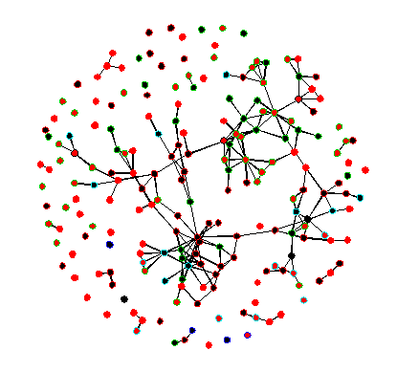
Data: Faux Mesa High
“This data set (formerly called “fauxhigh”) represents a simulation of an in-school [mutual] friendship network. The network is named faux.mesa.high because the school community on which it is based is in the rural western US, with a student body that is largely Hispanic and Native American.” (R package description)
Original reference: Hunter D.R., Goodreau S.M. and Handcock M.S. (2008). Goodness of Fit of Social Network Models,Journal of the American Statistical Association.
205 Students (9-12), 203 friendships

Slide 11
Format for Each Package
Live demo of core functionality
What kind of data do you need?
(Nominations, Adjacency Matrix, Edgelist, Other)
Basic network plots
Degree
Betweenness
Friends Means and Heterogeneity (when possible)
Demo of top features for non-specialists
Selection varies by package features
Tips for integrating with other analysis
Hassles and limitations

Slide 12
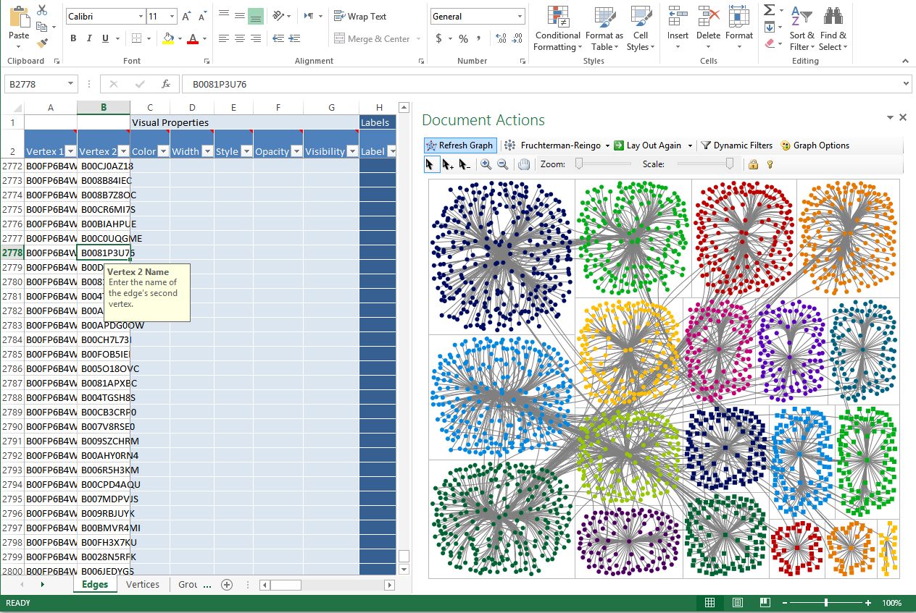
NodeXL: Shiny Now

Slide 13
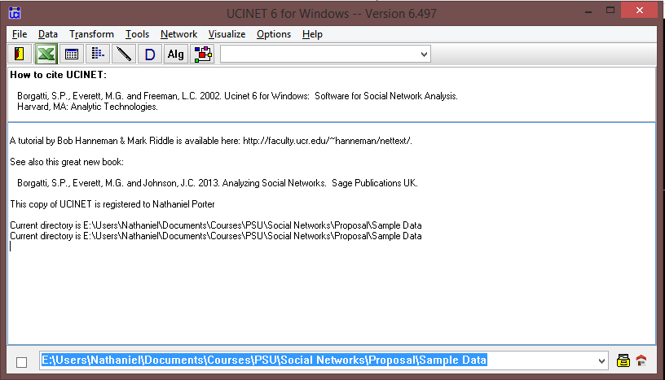
UCINET: Point and Click

Slide 14
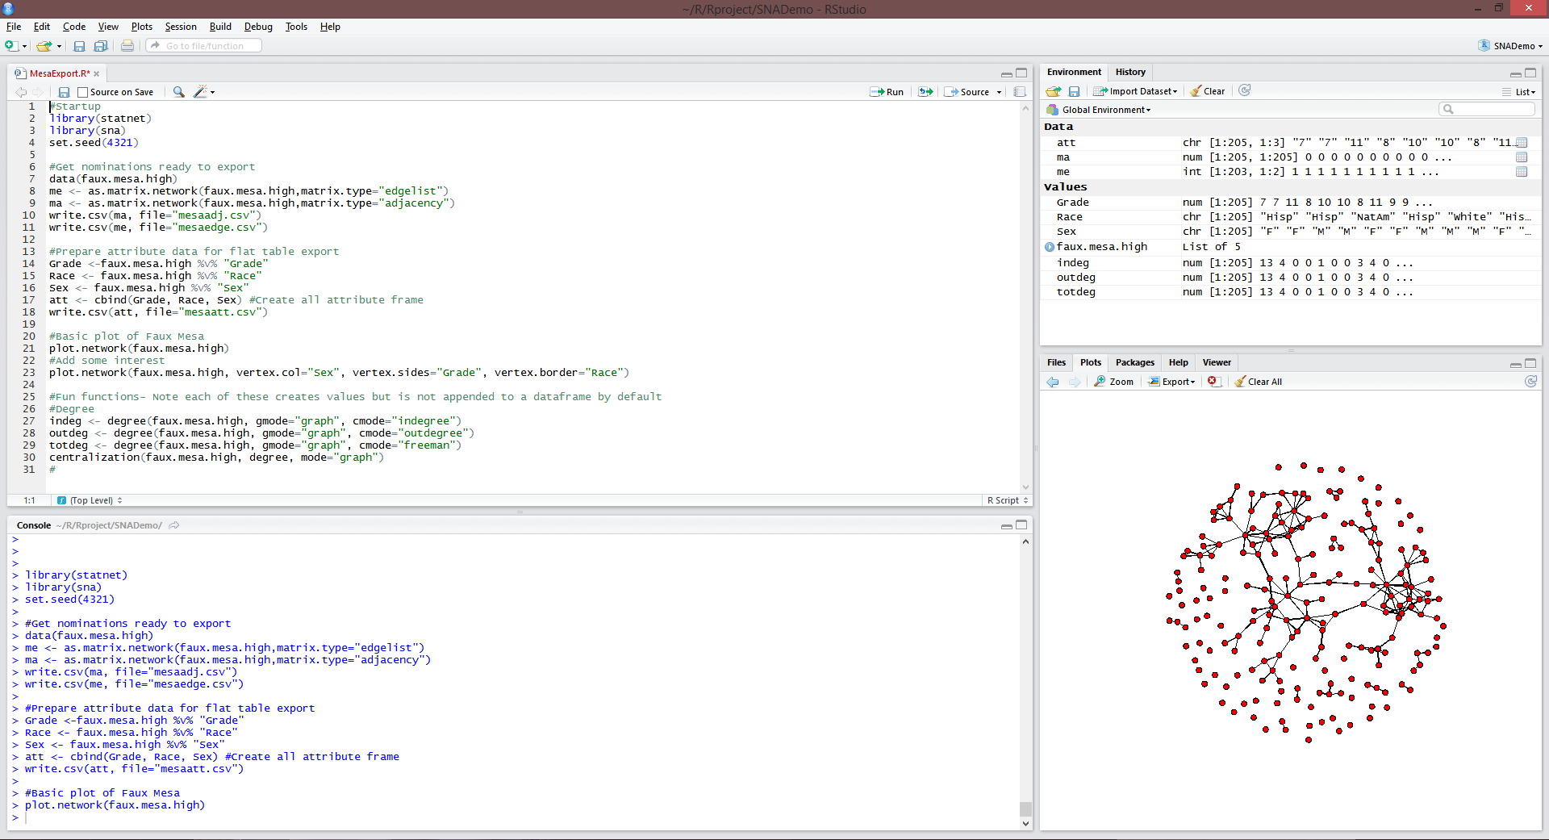
R: Anything You are Persistent Enough to Get

Slide 15
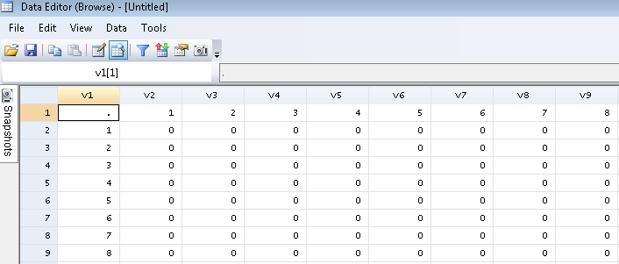
Stata: As Long as You’re Here

Slide 16
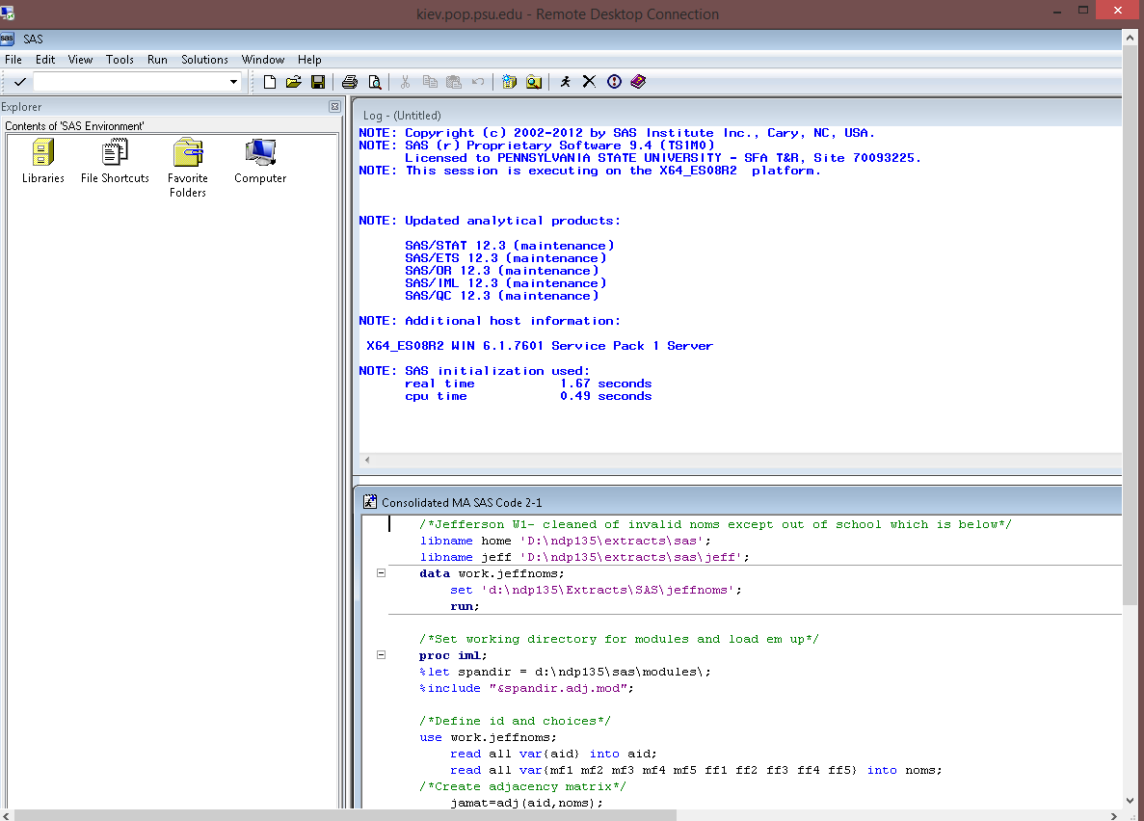
SAS: As Long as You’re Here II

Slide 17
Summary: How to Choose
Data form
Edgelist
Adjacency Matrix
Attributes?
Goals
Visualization
Quick Network Information
Integration in regression analysis
Personal Comfort Level
Use your package (if it works)
Know your limits
Cost
R: 100% free
NodeXL: Free plugin but only for Excel for Windows 2007-2013
UCINET: Free 60 days, then $40 student/$150 faculty perpetual license
Stata and SAS: Free plugins; paid software licenses

Slide 18
The Payoff!
Table IV: Two-wave Fixed Effects Regression on Subjective Religious Importance (N=2724)
 | Model I | Model II | Model III | Model IV
Ego Religiosity Worship Attendance Youth Group Participation Frequency of Prayer Biblical Literalism Born-again | .173 (.016)*** .030 (.014)* .232 (.013)*** .377 (.034)*** .141 (.033)*** | .168 (.016)*** .035 (.014)* .227 (.014)*** .371 (.034)*** .146 (.032)*** | .160 (.016)*** .038 (.013)** .219 (.013)*** .363 (.034)*** .154 (.032)*** | .154 (.016)*** .036 (.013)** .212 (.013)*** .342 (.034)*** .149 (.032)***
Ego Characteristics Grade level Core subjects GPA (4-point scale) |  | .081 (.021)*** -.023 (.021) | .048 (.022)* -.030 (.021) | .039 (.022) -.030 (.022)
Network Structure & Position Outdegree Bonacich (Prestige) Centrality |  |  | -.067 (.011)*** .175 (.039)*** | -.033 (.014)* .102 (.042)*
Friend Network Attributes Ego Network Mean Scores Proportion Claiming a Religion Mean Worship Attendance Mean Biblical Literalism Ego Network Heterogeneity Racial/Ethnic Heterogeneity Religious Heterogeneity |  |  |  | .078 (.080) .049 (.021)* .132 (.055)* .181 (.094) -.200 (.068)**
Constant | .870 (.048)*** | .080 (.247) | .551 (.263)* | .443 (.278)
Notes:
This sample table from my own work shows the value of network measures in regression. Friend religious heterogeneity (i.e. diversity) and friend mean religiosity and worship attendance are all important parts of the story of how people’s religiosity develops in adolescence.

Slide 19
Sources
Data (Faux Mesa High)
Hunter D.R., Goodreau S.M. and Handcock M.S. (2008). Goodness of Fit of Social Network Models,Journal of the American Statistical Association.
Stata Networks page maintained by Rense Corten
http://www.rensecorten.org/index.php/research/social-network-analysis-with-stata/
Primer on SNA using UCINET
Borgatti, Stephen P., Martin G. Everett, and Jeffrey C. Johnson. 2013. Analyzing Social Networks. Thousand Oaks, CA: Sage
Individual Software Packages
Links embedded in slide “Roadmap for Live Demo”

Slide 20
Acknowledgements
Presentation made possible by Penn State Quantitative Social Science Initiative (QuaSSI) and Big Data Social Science IGERT (BDSS)
All demo code and procedures available at http://github.com/ndporter/snademo

